Slide 1
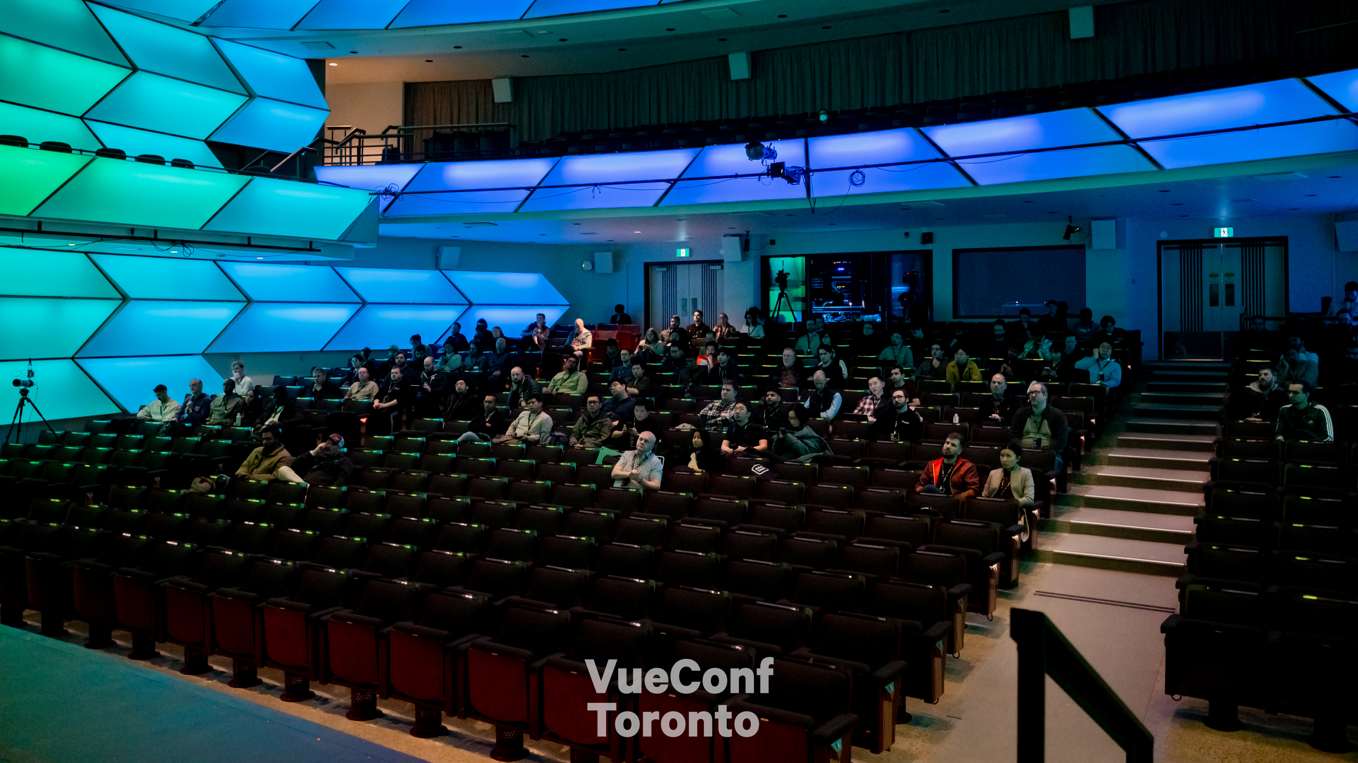
Notes:
And so, our fellowship ended, and I returned back to Stats, armed with a bit more confidence and little less self doubt.
Normally I would end the story here, but there’s one more thing…
Fast forward to last week, I was actually so lucky to attend the Vue.js Conference in Toronto.

Slide 2
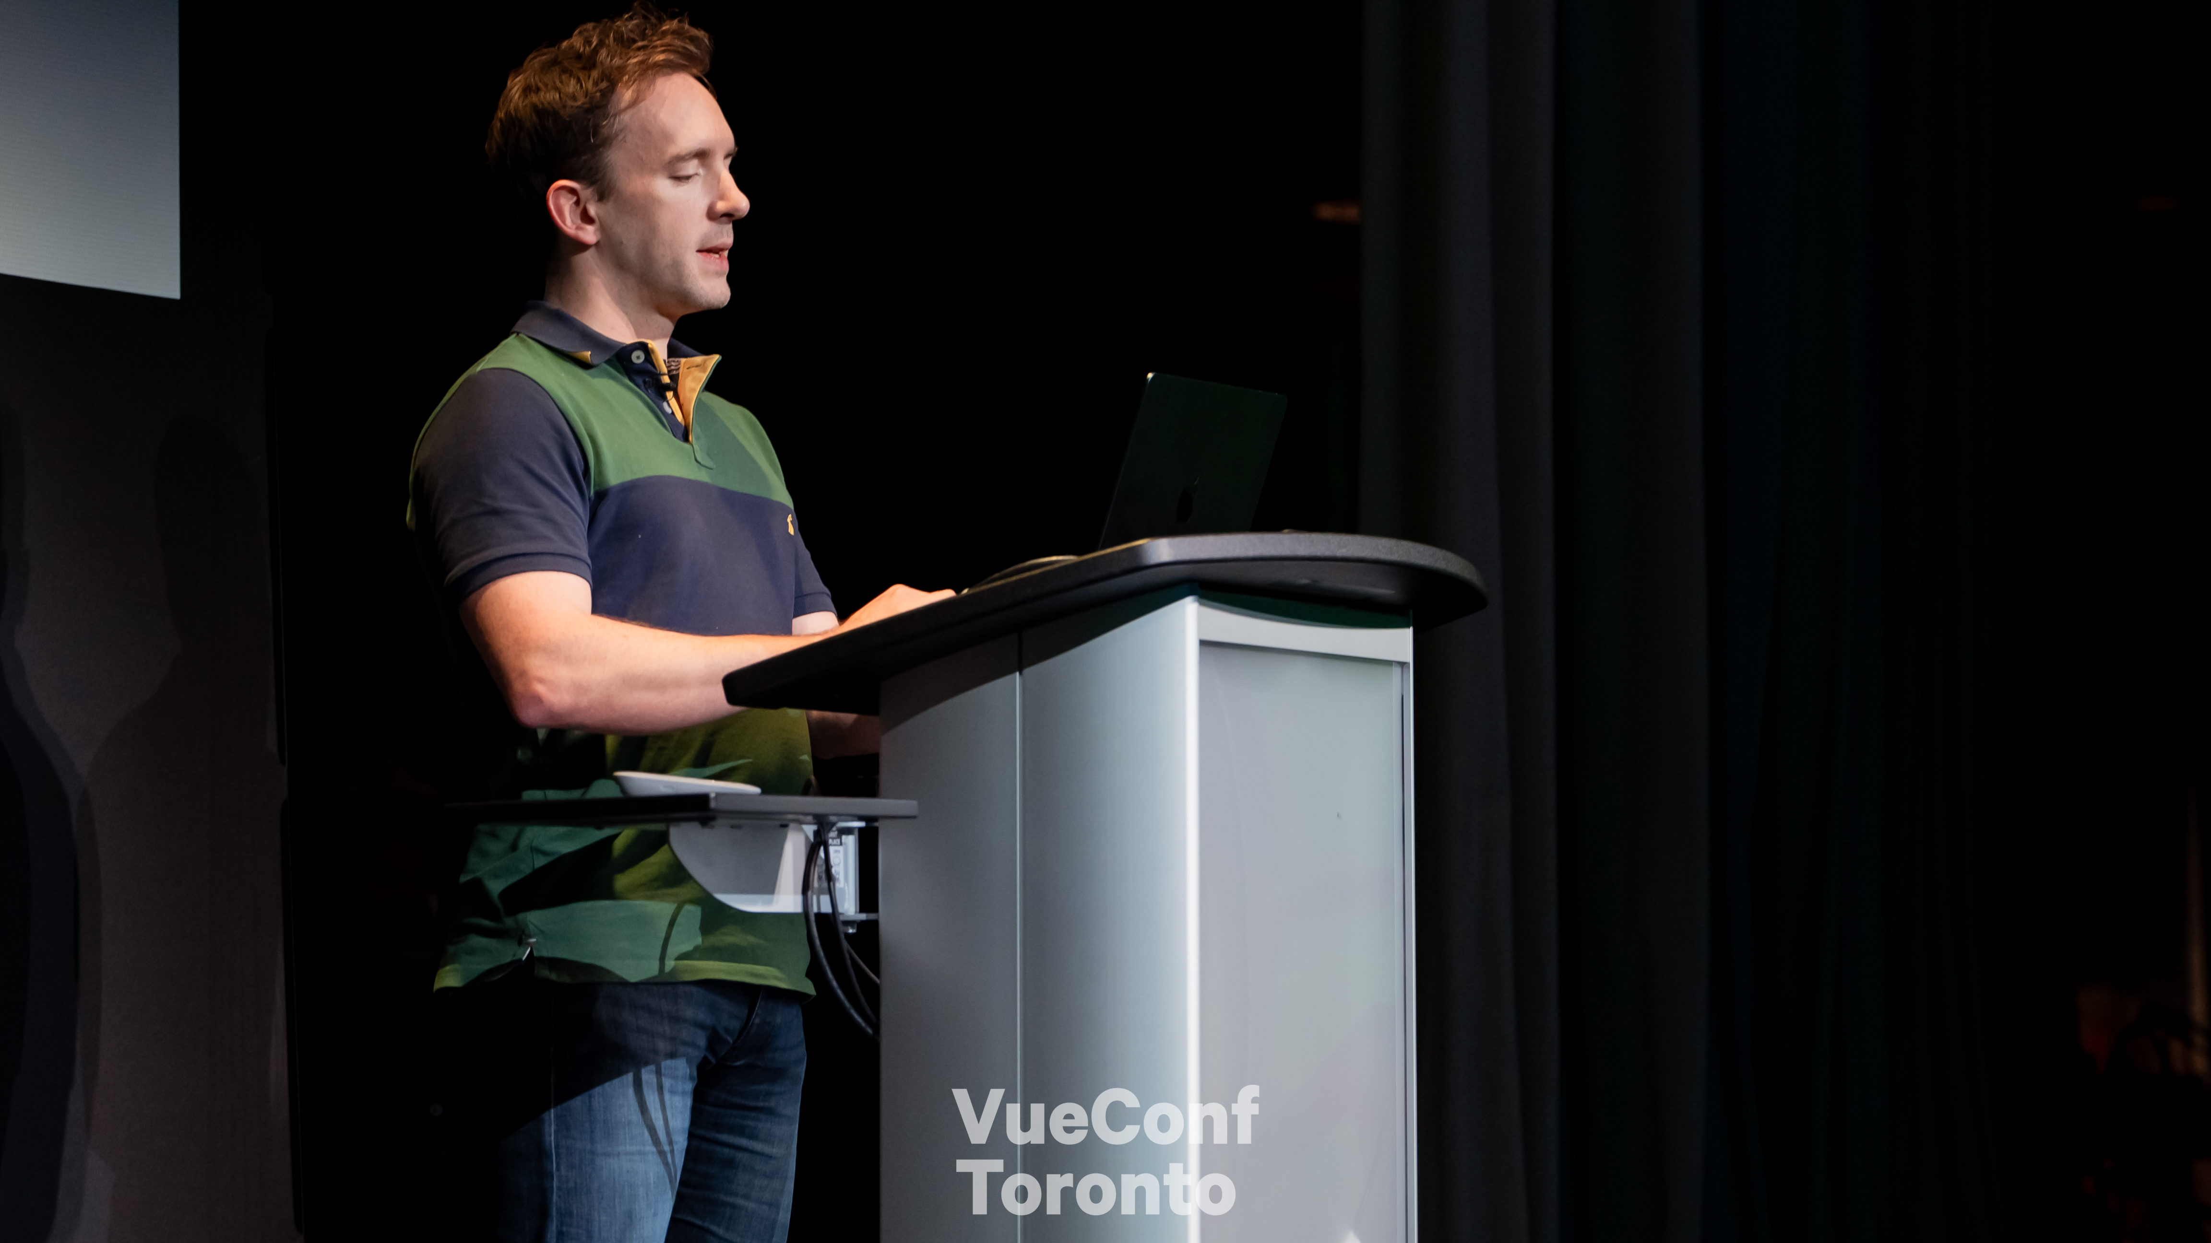
Notes:
And it was so cool.
I actually got to meet so many people in the community that helped me out many years ago.
I got to hear them speak and learn what they are building now.
That’s a shot of Daniel Roe speaking, the current maintainer of Nuxt.
And one of the most interesting things for me…

Slide 3
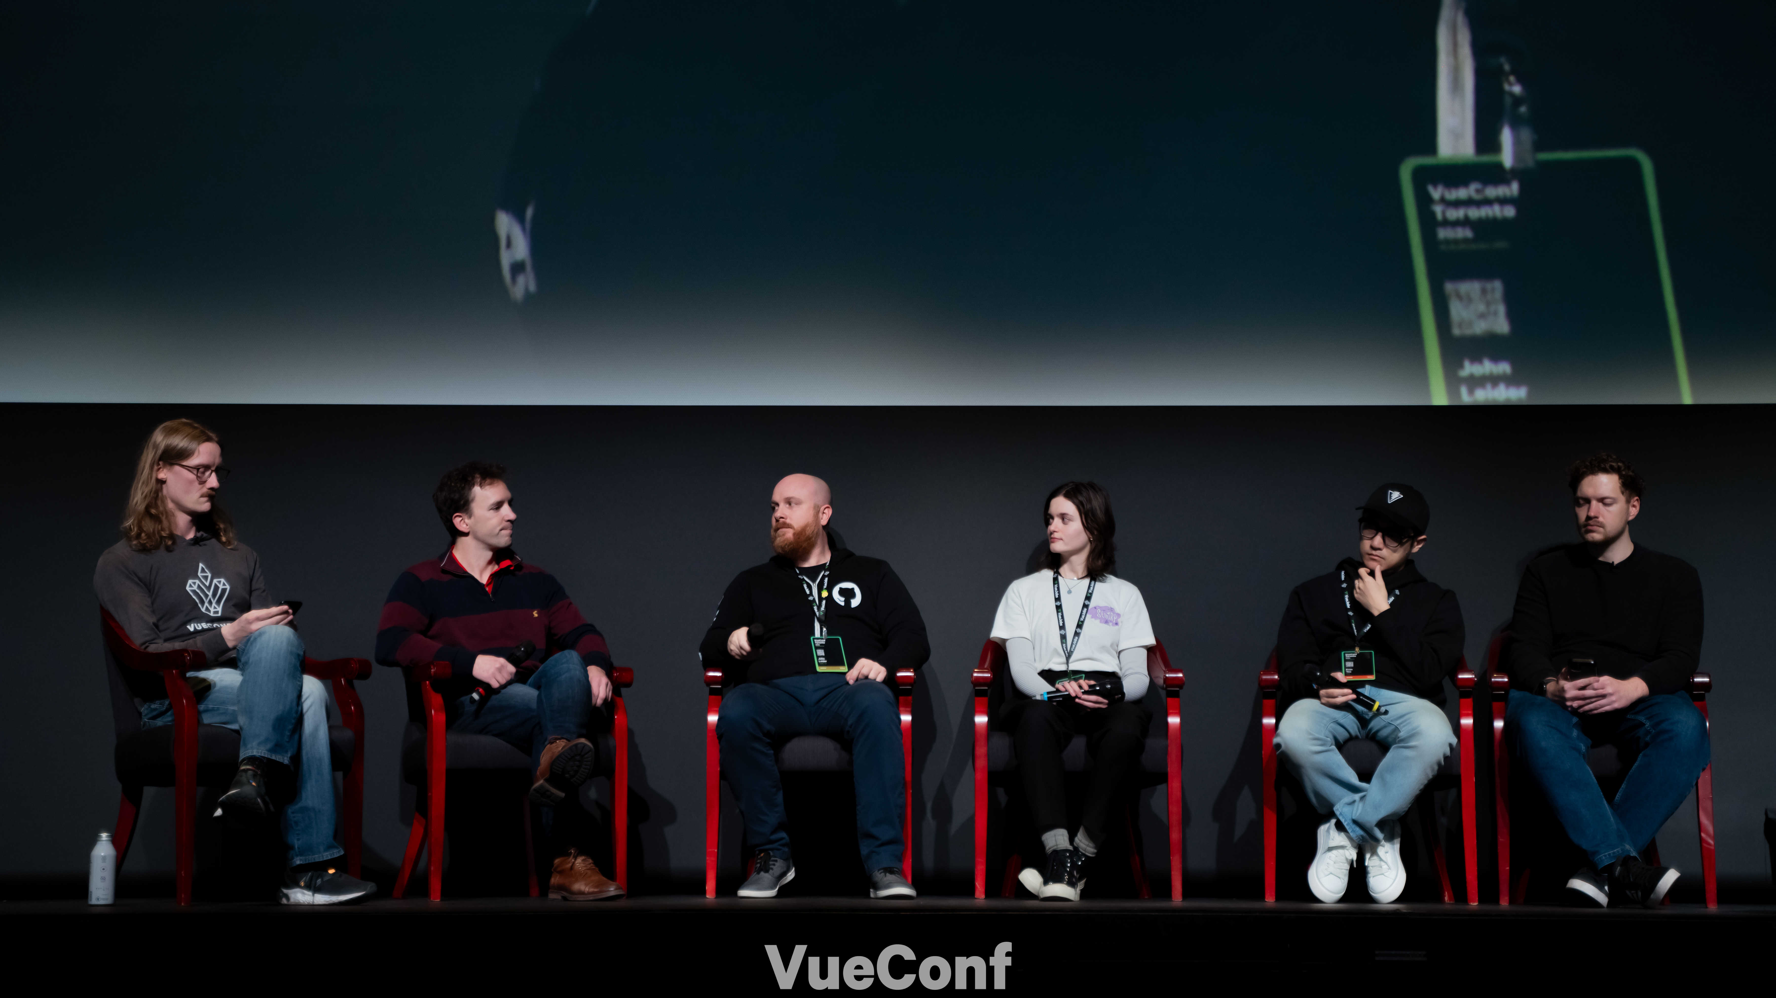
Notes:
There was a panel at the end of the conference.
And someone asked the speakers - “have you ever experienced imposter syndrome”
And it blew my mind, every person on the panel, said yes, that they too had felt some form of imposter syndrome in the past and shared a short story of their personal experiences, and what they did to combat it.
It was really profound, that I got to hear that from them.

Slide 4
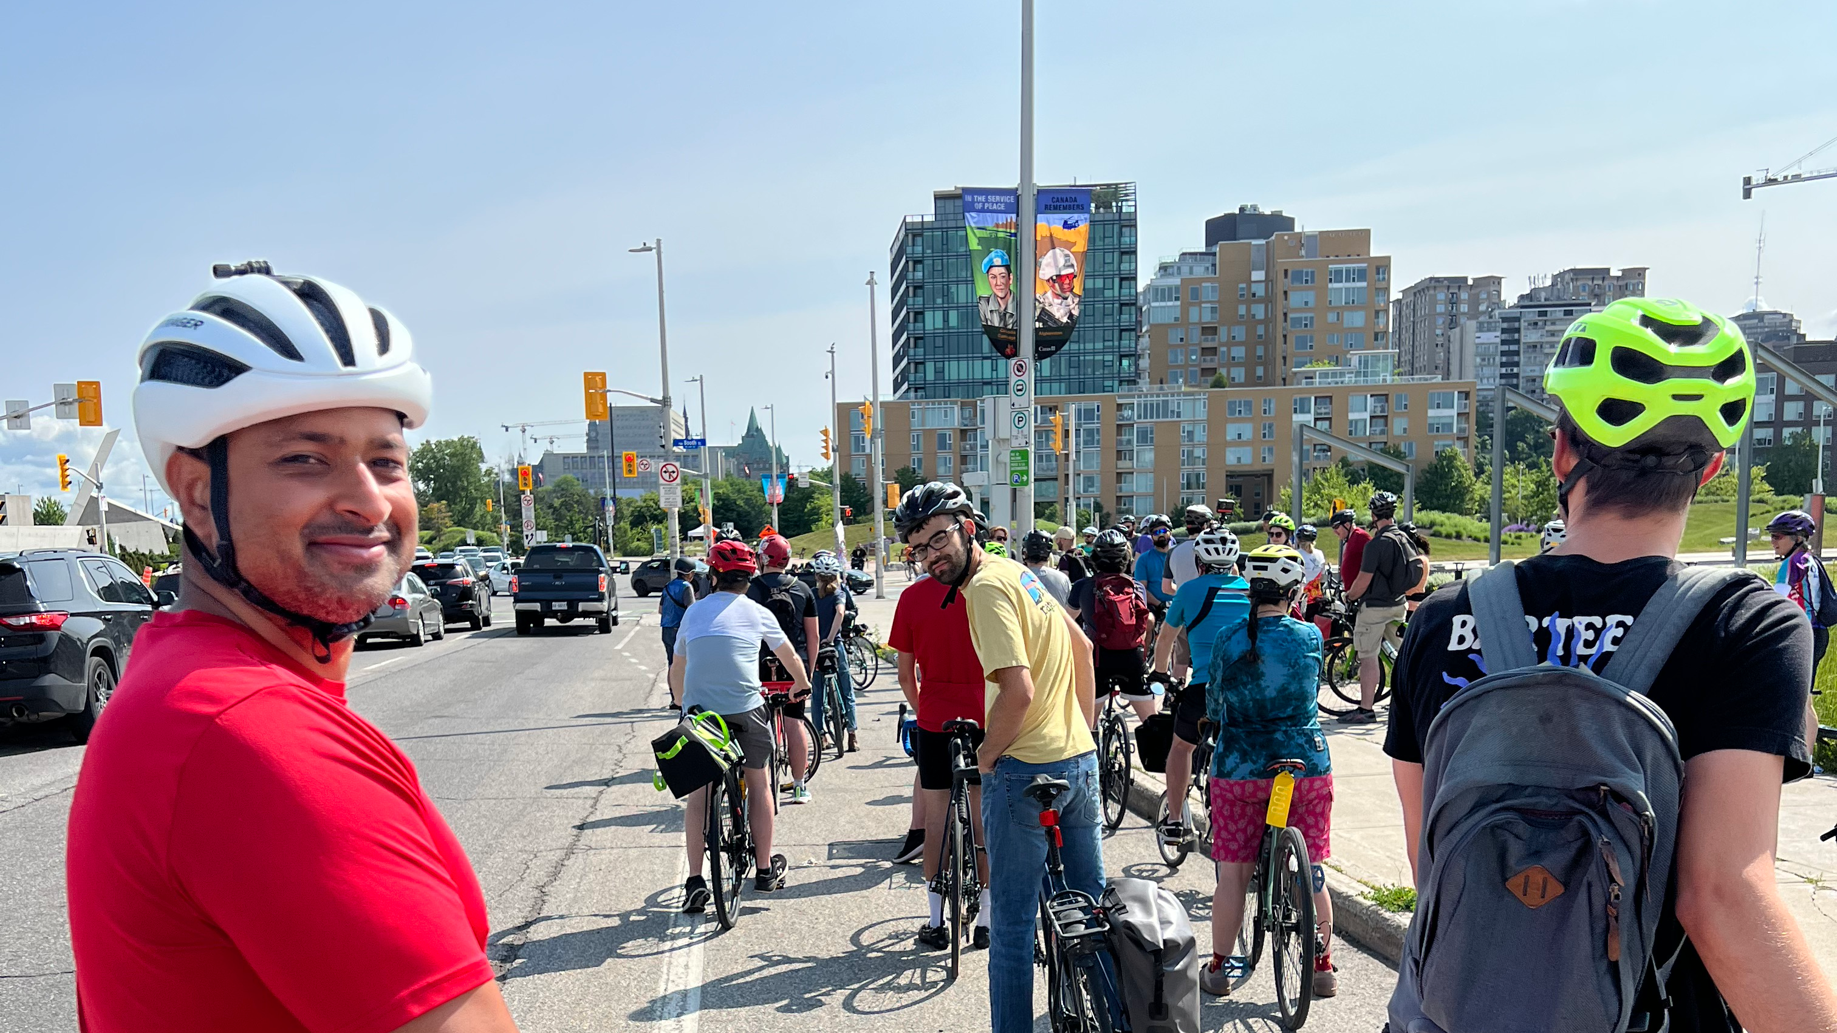
Notes:
And so, that’s my time for today.
But I just want to say:
You are all awesome. If you also feel self doubt, know that you belong.
You can do it. And if you get stuck and need a bit of help along the way, reach out to me, or reach out to your community, they’ll be there for you.

Slide 5
